Slide 1
Distributed Database System—Failure and Recovery (Capstone Project)
Supervisor Candidate
Professor Dr. Theo Owusu Om Prakash Dhakal

Slide 2
Introduction
Logical database, spread physically across computers in various locations through communication link.
Data Stored--several nodes(sites),geographically or administratively across interconnected computer network
Each site running in independent database system
One Global Schema exists, which allows local users to access remote data

Slide 3
Objective of Distributed database
Location Transparency—ease of access of data for many different locations
Location autonomy—capability to administrator a local database, operate independently, when connection to other nodes have failed.
Faster response—speeds up query processing possible to split complex queries to sub queries and processed in parallel sites

Slide 4
Problem statement
Despite a lot of research over distributed database system, the challenges in a database failures and recovery techniques are still remain unsolved.

Slide 5
Research questions
Which collaborating components(hardware, software, communication)played pivotal role to fail data in distributed database system?
How deadlocks are created in distributed system, how does it effects to manage data, and how can deadlocks be prevented in efficient ways?
How easy is it to perform data recovery issues? And what are the challenges of replicating data in different geo-graphical locations and how these challenges will impact in data replication process?

Slide 6
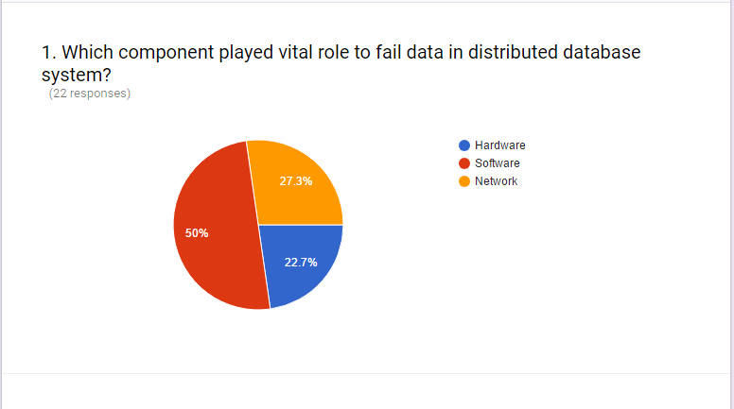
Data fail conditions portion of the survey:

Slide 7
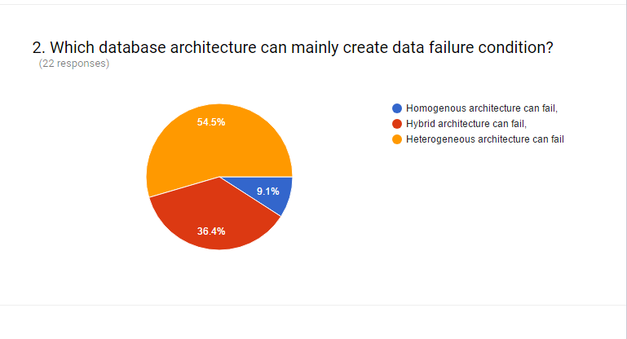
Data fail conditions portion of the survey:

Slide 8
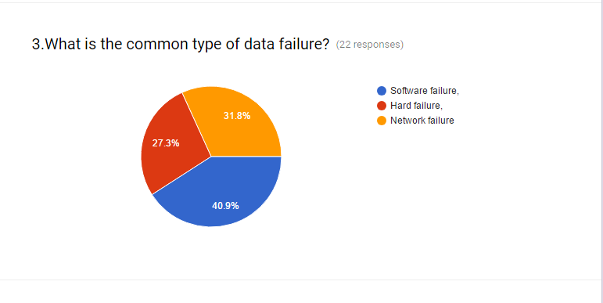
Data fail conditions portion of the survey:

Slide 9
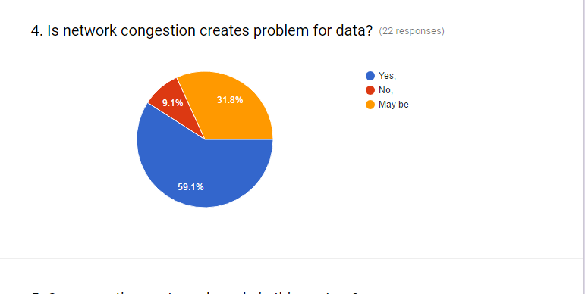
Data fail conditions portion of the survey:

Slide 10
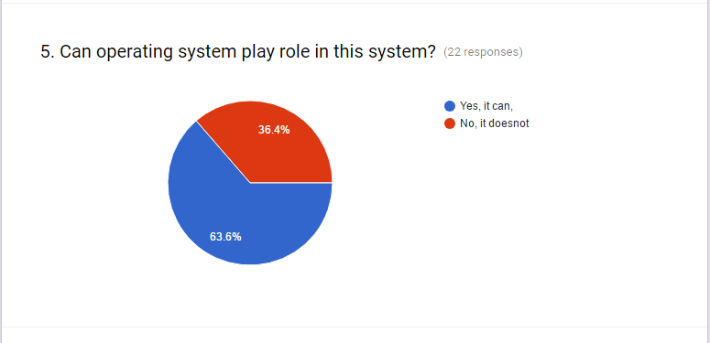
Data fail conditions portion of the survey:

Slide 11
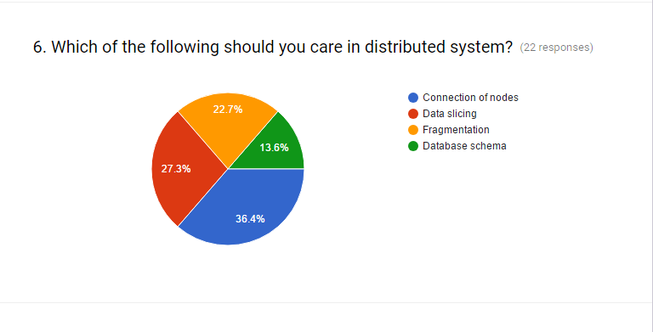
Data fail conditions portion of the survey:

Slide 12
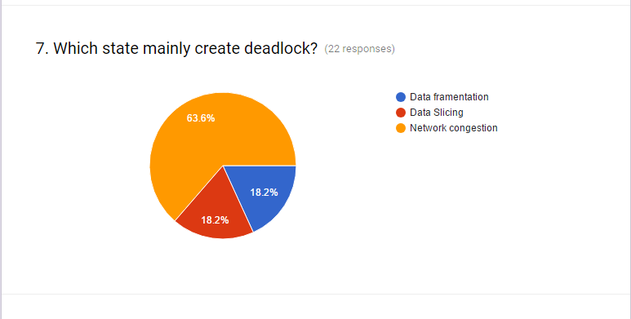
Deadlock portion of survey:

Slide 13
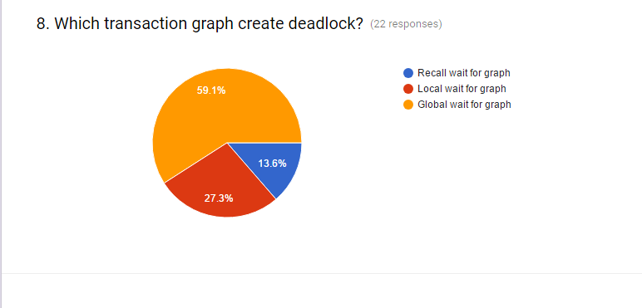
Deadlock portion of survey:

Slide 14
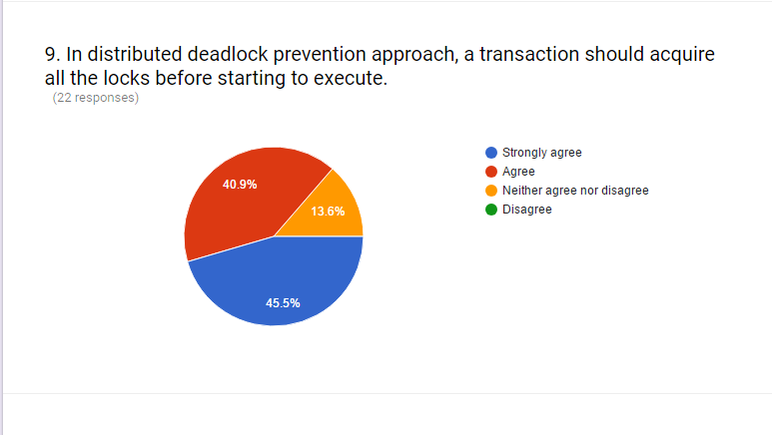
Deadlock portion of survey:

Slide 15
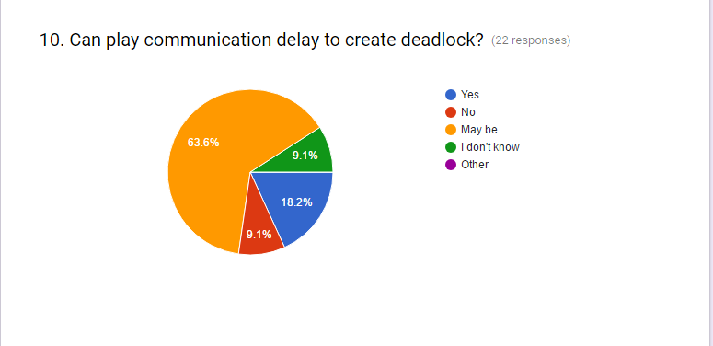
Deadlock portion of survey:

Slide 16
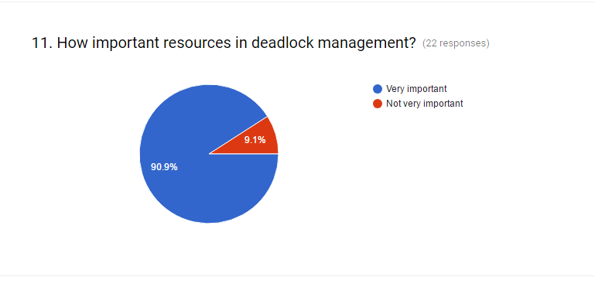
Deadlock portion of survey:

Slide 17
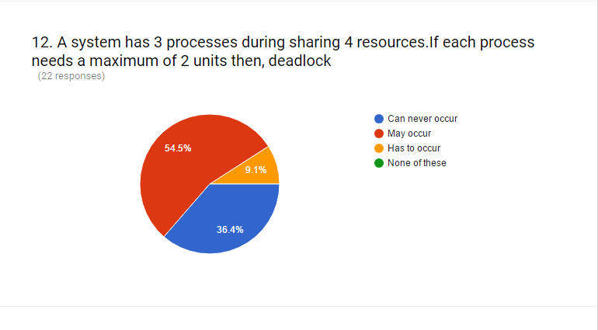
Deadlock portion of survey:

Slide 18
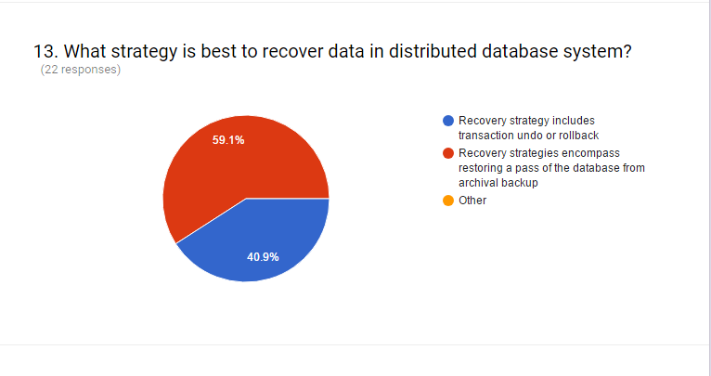
Deadlock portion of survey:

Slide 19
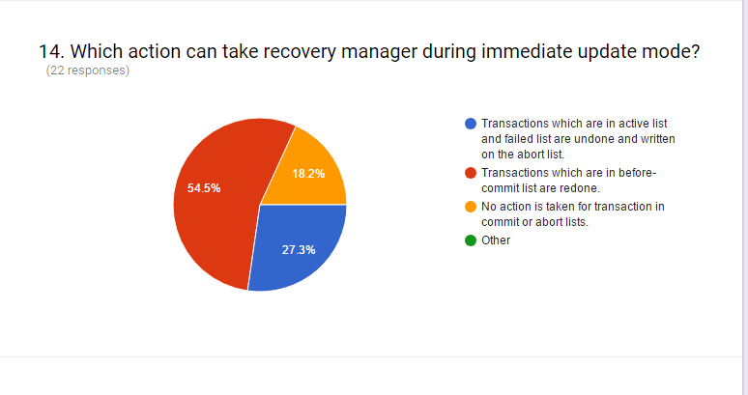
Data recovery portion of survey:

Slide 20
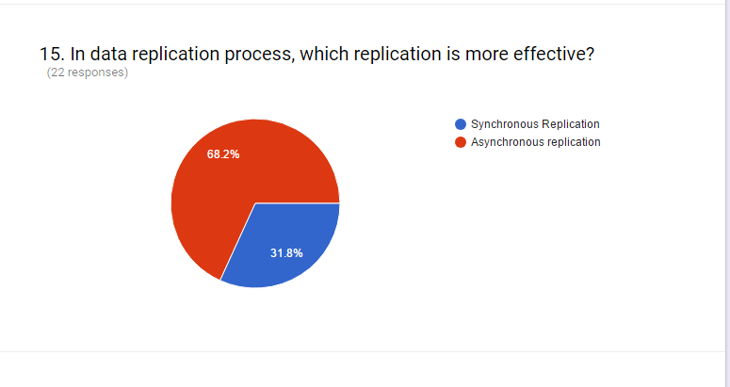
Data recovery portion of survey:

Slide 21
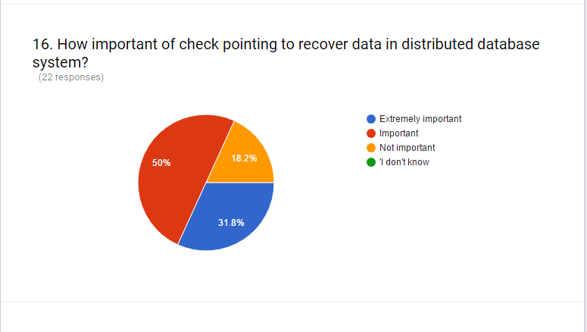
Data recovery portion of survey:

Slide 22
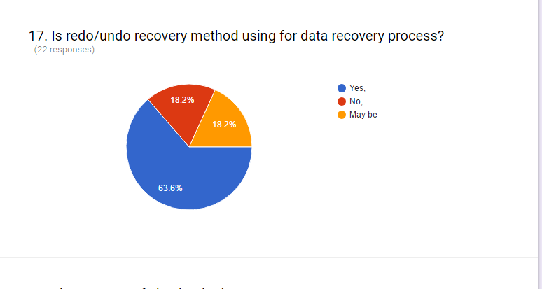
Data recovery portion of survey:

Slide 23
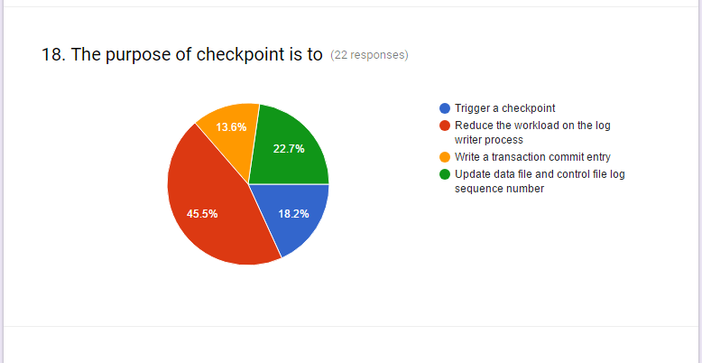
Data recovery portion of survey:

Slide 24
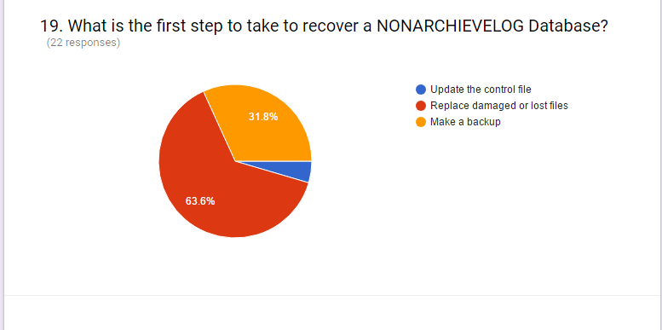
Data recovery portion of survey:

Slide 25
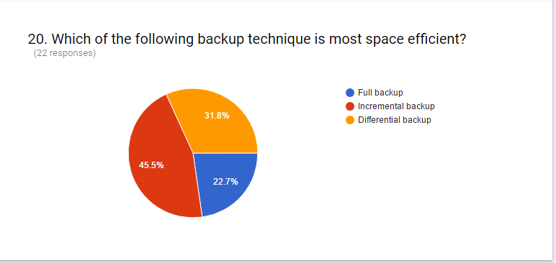
Data recovery portion of survey:

Slide 26
Analysis the results of first research question
The component software(50%) can fail data
Heterogeneous architecture(54.5%) can fail data
Other reasons to fail data--network congestion, operating system and connection of nodes

Slide 27
Analysis the results of second research question
Network congestion state(63.6%) can create deadlock
Global wait for graph(59.1%) can create deadlock
Communication delay may be create deadlock

Slide 28
Analysis the results of third research question
Transaction undo/redo strategy(59.1%) use to recover data.
Action that can be done during immediate mode in recovery process.
Asynchronous replication(68.2%) can be effective in recovery process

Slide 29
Recommendation for data failure condition
Should be focus on software(50%),what kind of software is using
Concentrate particularly on database architecture, homogenous architecture can be used.
Try to detect network state, operating system and nodes

Slide 30
Recommendation for deadlock
Should be reduce network congestion problem
Focused on Global wait for graph and communication delay
Can be use locked and time based concurrency control algorithm can be used to detect

Slide 31
Recommendation for data recovery strategy
Can be use archival backup rather than transaction undo or rollback.
Asynchronous replication method can be used
Recovery through various levels:
Recovery to a correct state
Recovery to a checkpoint current state
Recovery to a possible previous state
Recovery to a valid consistent state

Slide 32
Thank You
Queries???

